Slide 1

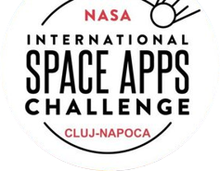

Agota Radoi Riger Lucian Muntean Paul Nistor Victor Veltan
between us and the stars…
Powered by

Slide 2
What we thought
What we learned
What we’re doing
about it
Why did we pick this challenge?
Space debris monitoring app for general use with geopositioning and advanced filtering capabilities, meant to be used to raise awareness and offer insights on the history of space flight.

Slide 3
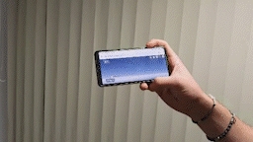
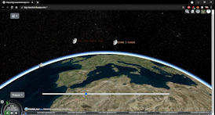
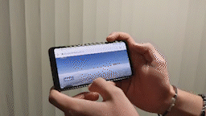
Demo
The app displays space debris flying in real time above to the viewer’s location
By clicking on the icon of the debris, further information is displayed
The user can commute between seeing the object only or its entire trajectory
Time can be manipulated back and forth (1 week into the future the calculations remain accurate)
Advanced filtering is work in progress
Please note: if the transitions between the images on the gifs are not smooth, please go to the actual app to review the functionality:
https://big-nasa.herokuapp.com/
Also, the demos were done with a limited number of satellites, because the system was still work in progress.
The user can choose to jump from one location to another (currently only cities are recognized)

Slide 4
Feature List

Slide 5
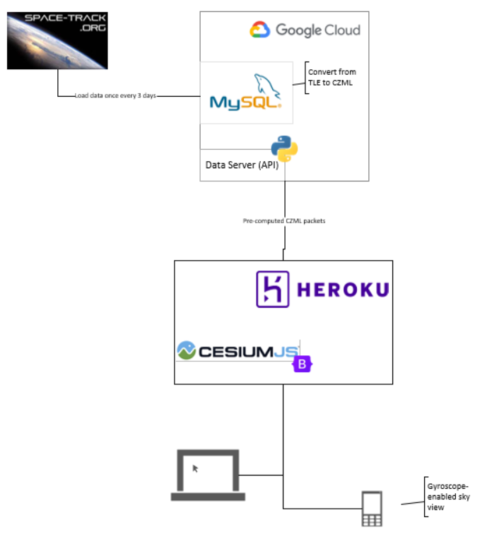
Architecture, Tech Stack & Technical Challenges
Space-Track has API throttling in place, making querying difficult (we still wanted to use it as data quality was best from this provider)
Displaying large amounts of data in a way that is appealing and meaningful to the end-user
Dealing with limited screen-space (on mobile devices)
Computation done on server-side so as not to overwhelm the client

Slide 6




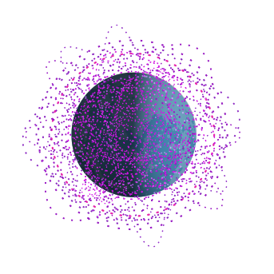
Thank you for the opportunity!
Main gains from our project
General public -> awareness, this very important topic made approachable, future generations educated early on the topic
Engineers’ community -> might get an appetite/idea for exploring such opportunities
Us -> awesome occasion to learn and develop our skills

